Slide 1
EPS and XPS Infrastructure Ban
Major Research Findings

Slide 2
Overview
Market Research
Effects, Chemical properties, Potential alternatives
Regulatory Review
Regulation requirements
Jurisdictional Scan
Case studies in Washington, Ontario, Taiwan
Recommendations for Targeted Campaign

Slide 3
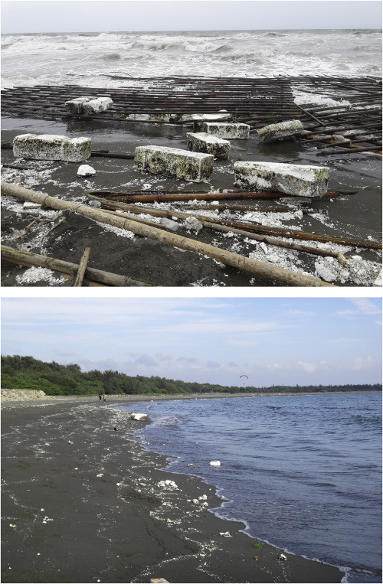
Applications of EPS/XPS
Expanded Polystyrene & Extruded Polystyrene are foamed plastic mostly made up of air(95%)
EPS and XPS are widely employed in various industries
Lightweight, buoyant, durable
Commonly favorable in packaging, construction, and marine applications
EPS is more favorable in marine application: docks, buoys, floats, and fishing gear

Slide 4
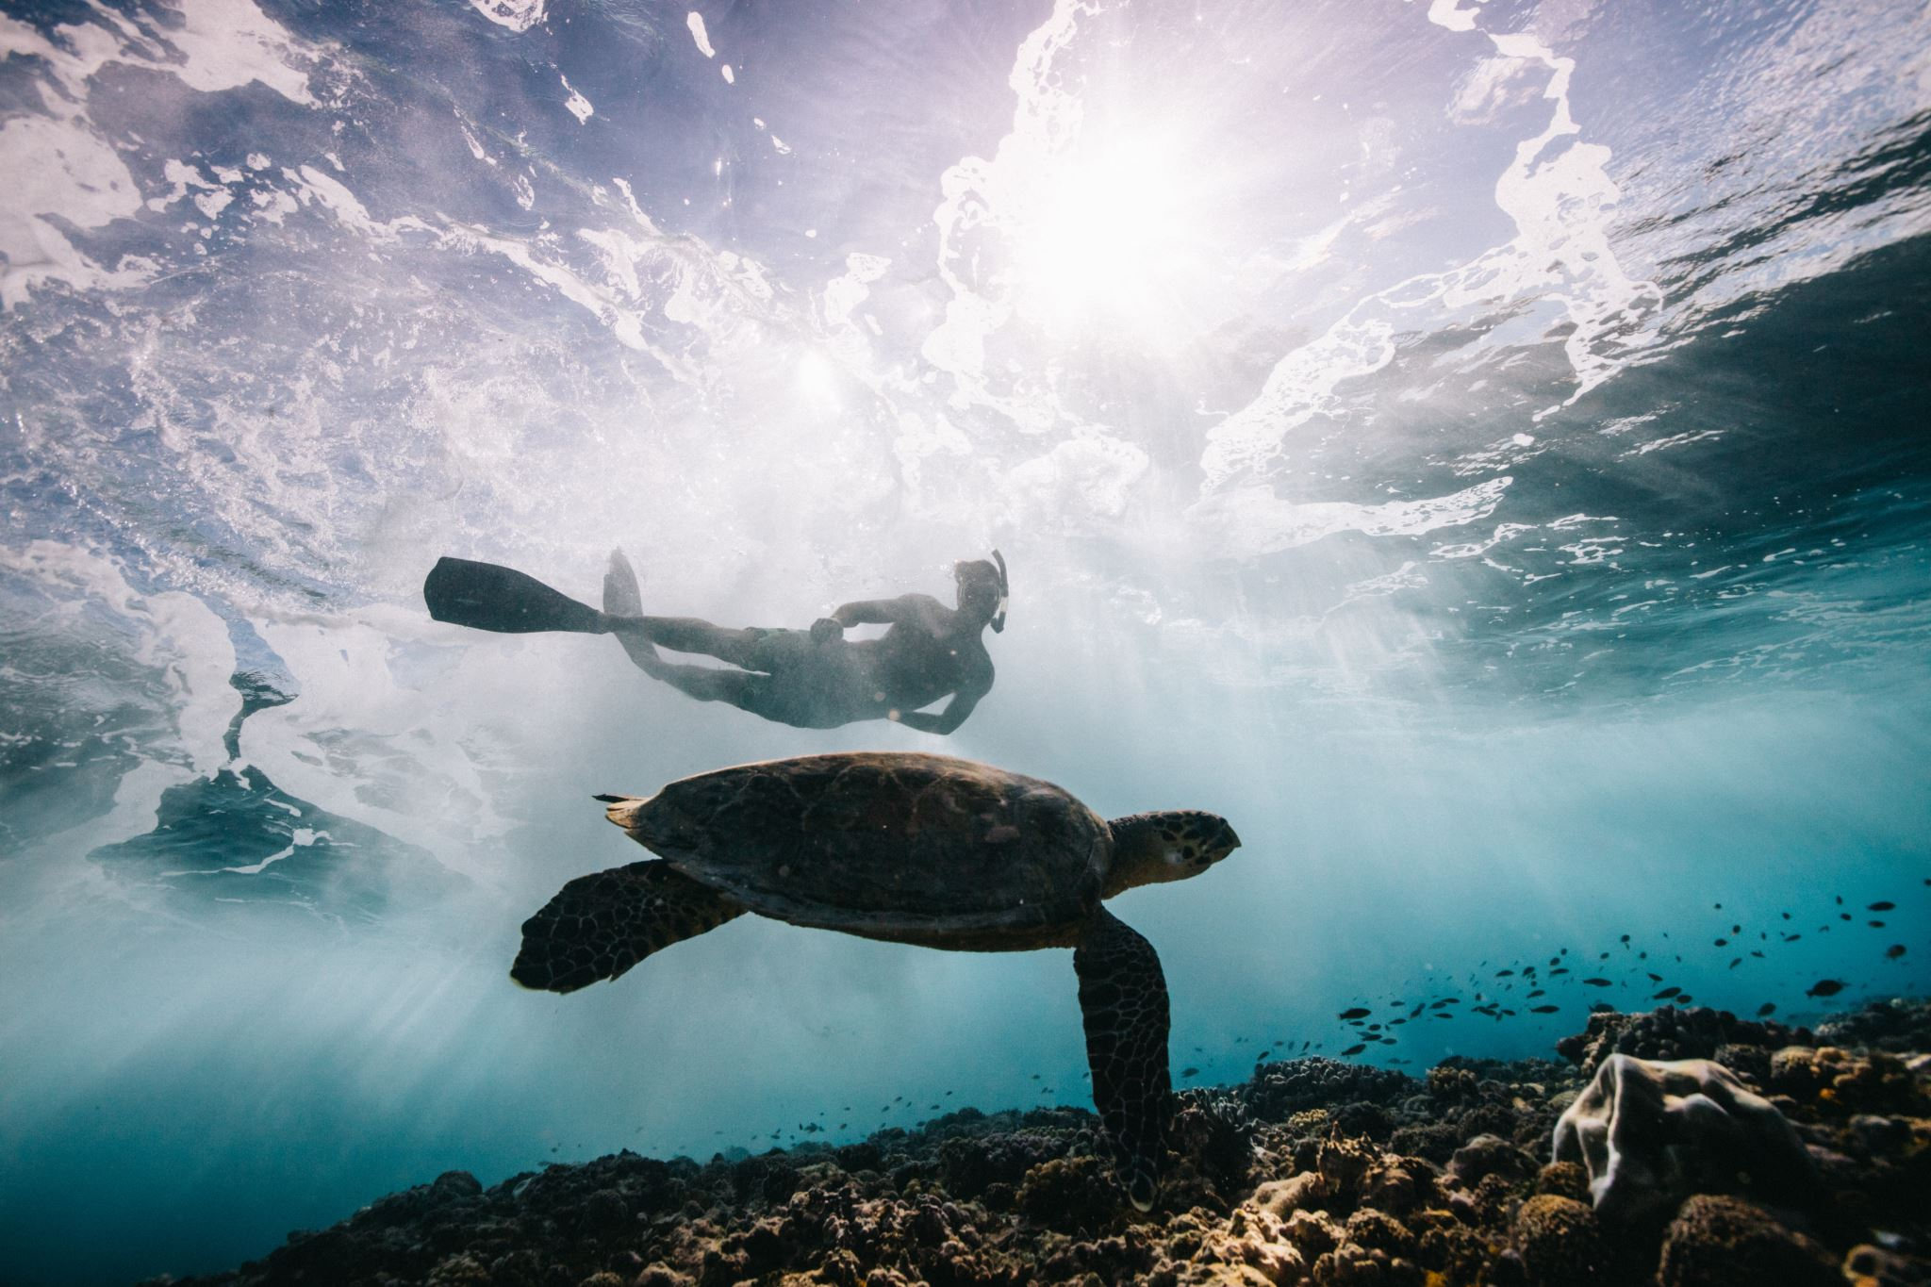
Understanding the Impact of EPS and XPS on Marine Ecosystem
Lifecycle of plastic is a major source of greenhouse gas emissions
Non-biodegradable and can persist in marine environments for hundreds of years.
Continues to break down to microbeads that are impossible to clean up

Slide 5
The EPS and XPS Problem
5 to 13 million metric tons of plastic being released into the ocean from coastal cities each year
2000 $ to clean up each KM of coastline in BC
Low Recycling Rate(~9%)

Slide 6
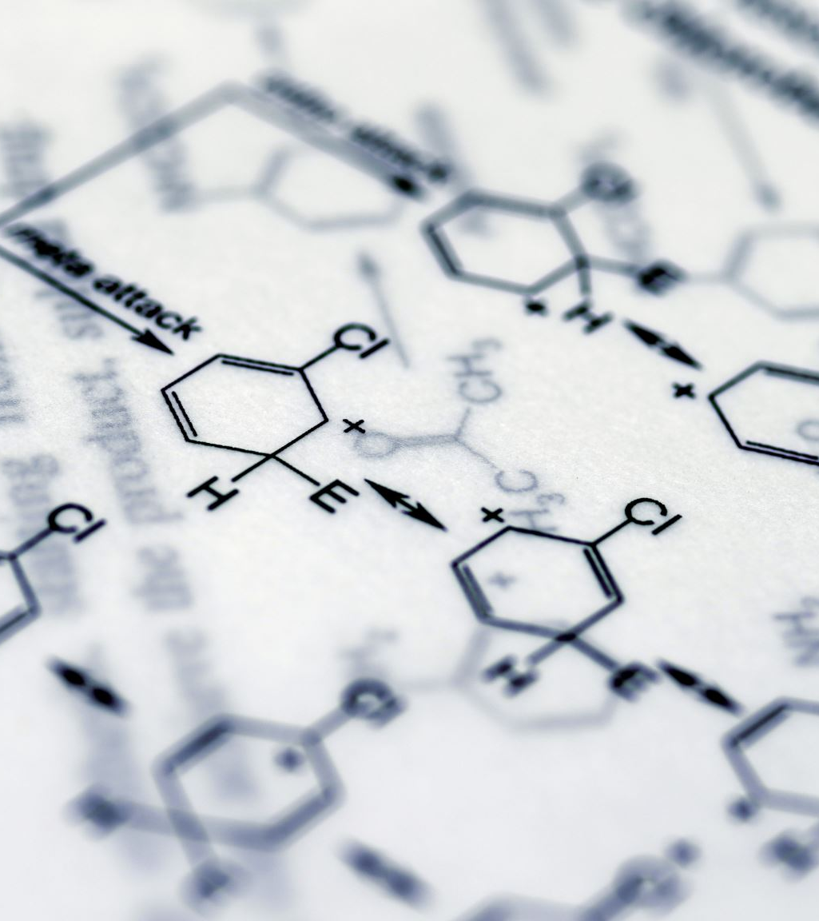
Chemical Contaminants and Toxins
Hexabromocyclododecane- HBCD
Typical concentration from 0.7-2.5% by raw EPS weight, XPS have higher concentrations
Forecasted increase of HBCD
Have negative impacts on the environment and human health
Threatens the well-being of marine mammals and sea birds

Slide 7
Chemical Contaminants and Toxins(Cont’d)
Benzene: health risks associated with long-term exposure, including skin scaling, leukemia, plastic anemia, and even the potential for fatalities. Toxic level: 5.3 ug/L
Styrene: health risks linked to prolonged exposure to styrene, such as balance issues, learning impairments, fetal damage, reduced female fertility, and the development of lung cancer.
Ethylene: is flammable in large quantities

Slide 8
Alternative Materials
Air-filled Floatation Devices:
More durable, Cheaper in long-run
High-Density Polyethylene (HDPE) Floats:
UV resistant, more durable
Concrete or Steel Structures to Encase Aquaculture Infrastructure:
exceptional durability and strength, higher cost
Natural Fiber Composites:
Biodegradable and Renewable

Slide 9
Alternatives-EPS Recycling Program
From 2011 through 2017 reference data from the Canadian Plastics Industry Association’s (CPIA) annual Post-Consumer Plastics Recycling in Canada Report. The 2018 & 2019 Canadian EPS Recycling Reports were conducted by the EPS Industry Alliance (EPS-IA) & reflect both post-use and post-industrial expanded polystyrene recycling(Source: Polyform, 2020).

Slide 10
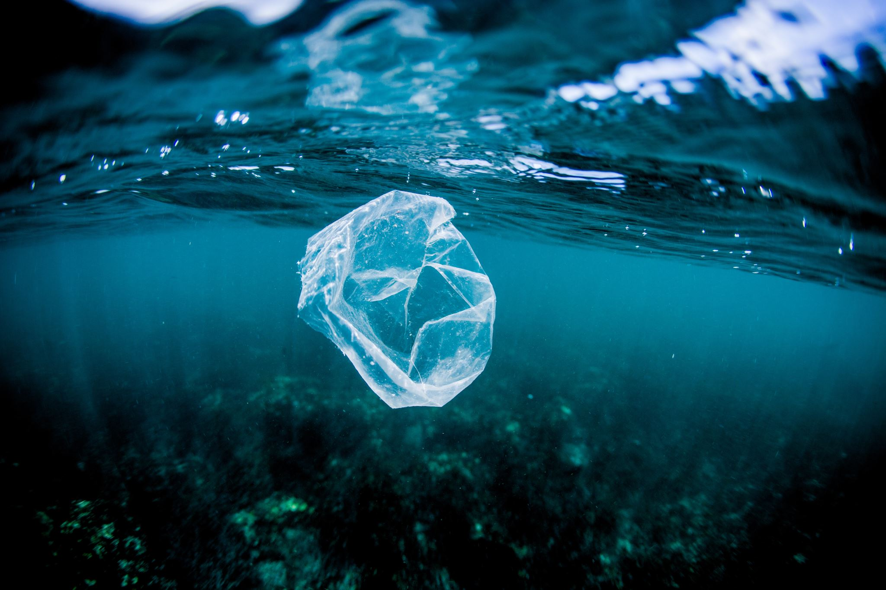
Relevant Regulations on EPS/XPS
Zero Plastic Waste Plan
No explicit Regulations to limit EPS and XPS use in aquatic environments
Fisheries
Infrastructure Activities
Dock Application Guidelines
XPS and EPS Management

Slide 11
Environmental Regulations: Canadian Environmental Protection Act (CEPA)
Developed in 1999
Assessing and mitigating risks associated with chemicals, polymers, and living organisms
Tackles air and water pollution, hazardous waste management, regulation of air pollutants, and monitoring greenhouse gas emissions.
Central role in the protection of Canada's ocean health and overall environmental well-being through its comprehensive regulations and proactive initiatives.

Slide 12
CEPA Amendment Pathway
Overview of the CEPA amendment process.
Bill S-5 amendments and their potential impact on the regulation of toxic substances
Part 1 focuses on substances of the highest risk, aiming for complete prohibition. It includes 19 substances, such as DDT.
Part 2 addresses substances of lower risk, with an emphasis on pollution prevention rather than eradication. It includes 132 substances, including asbestos, lead, petroleum, and single-use plastics.
Clear Definition of Toxic Substance for a Provincial and Federal Ban

Slide 13
Ontario Case Study: Bill 228 Keeping Polystyrene Out of Ontario's Lakes and Rivers Act, 2021
Mandating encapsulation of EPS in floating docks, platforms, and buoys.Protecting aquatic ecosystems and clean waters. Factors contributing to the bill's success.
Factors contributing to Success
Support from environmental organizations.
Online petitions and community endorsements.
Economic analyses favoring encapsulated foam.
Precedent cases from the US.
Volunteer programs highlighting foam pollution.

Slide 14
Cases in the US
Oregon
The Oregon Foam Encapsulation Policy
Regulations to prevent EPS disintegration in water bodies
Approved encapsulation methods and exemptions
U.S. Army Corps of Engineers (USACE)
Insights from the USACE's experience
Challenges in enforcing encapsulation policies
Importance of clear and precise policies
Washington
Washington Senate Bill 5546
Addressing environmental impact of EPS in docks and buoys.
Mandating encapsulation and removal of non-encapsulated foam

Slide 15
Case Study in Taiwan Addressing Styrofoam Buoy Marine Debris
Challenges in managing Styrofoam buoy marine debris. Measures implemented in Taiwan.
Positive outcomes and lessons learned
Raft Marking Enforcement: Illegal rafts without required marks faced penalties, reducing discrepancies over time:
Difference reduced from 1,200 in 2010 to 75 in 2015.
Highlighting the success of this strategy.
Recovery Rate Requirement: Mandated recovery of at least 80% of rafts over two years, leading to improvement:
Recovery rate increased from 80.9% in 2012 to 97.4% in 2016.
Incentive Program: Farmers were rewarded for buoy recovery, resulting in retrieval of about 20–33% of discarded buoys.
These measures demonstrated progress in managing Styrofoam buoy marine debris in Taiwan, offering insights for similar challenges worldwide.

Slide 16
Recommendations
Research and Development
Monitoring and Assessment
Continued Beach Clean up efforts
Pathway to amend CEPA
Development of Eco-Labeling
Awareness and Education

Slide 17
Final Remarks

